Slide 1

ML Based Predictive Model for Chip Sizes Using Raw Potato Size Data
Pallavi Gupta
University of Missouri(Columbia)
R&D - Data Science and Analytics
Date - August 6, 2020

Slide 2







About Me
Background
Born and raised in Shimla, India (a town in Himalayas)
Family in India
Lays Chips are my favorite PepsiCo product.
Education
Currently pursuing PhD in Informatics from University of Missouri(Mizzou)
M.S. (Bioinformatics & Computational Biology) from Saint Louis University(SLU)
Bachelors in Engineering (Biotech) from India
Experience
Currently working as a Graduate Research fellow (Mizzou),since past 1 year..
Worked as a Graduate Research assistant (SLU) for 2 years.
~5 years of work experience as a Software analyst in India.
Interests
Travelling and exploring new parts of the world.
Love to explore new food(foodie)
DIY creative decorations & cooking, when at home

Slide 3
Agenda
Introduction
Objectives
Project Significance
Methodology
Results & Analysis
Recommendations

Slide 4
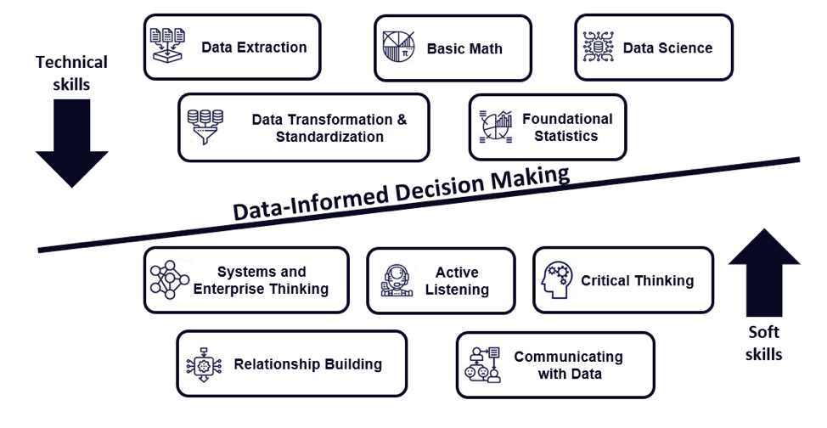

Introduction - Data Science & Analytics
Machine Learning & AI
Notes:
This is the perfect slide for introduction to data science. All these things go to do even a simple project in data science. My internship also looks like the same to define how much efforts I have applied.
That is the state of my mind in the first week or before any ML related project.
What is data about?
What is the success metric?
How to structure the data?
Technology that can be applied to data?
Oh wait are there are any biases?

Slide 5

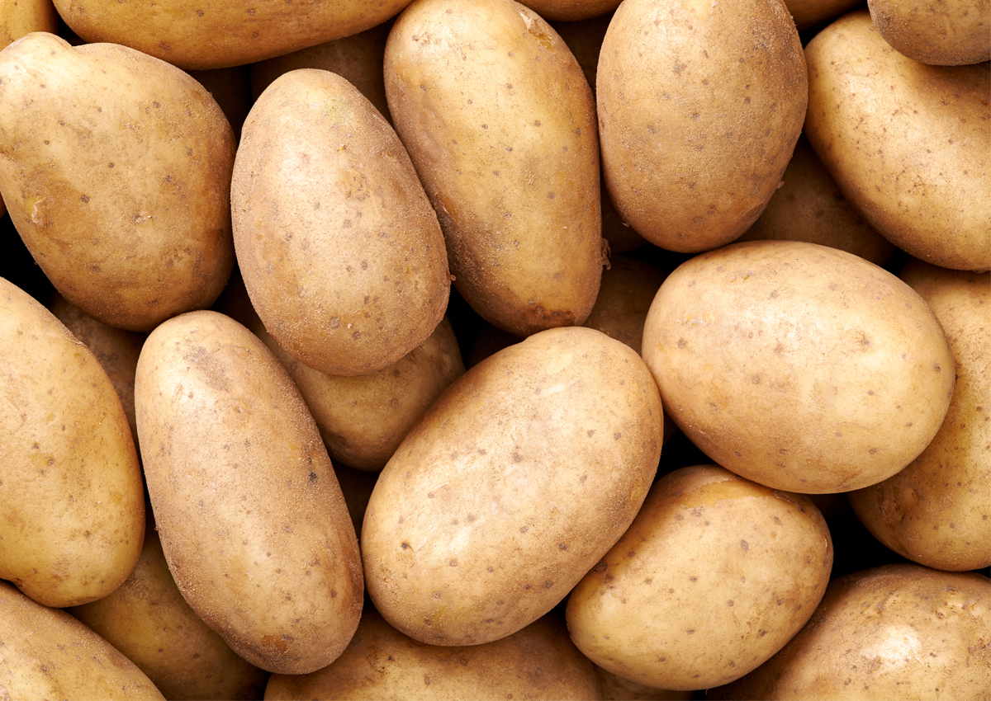
Objective
To build a machine learning based prediction model to be able to predict the %age of chips produced (having length >2.5 inches), from each truckload of potatoes.

Slide 6
Project Significance
This project would help the chips production team to estimate the right quantity of small packets to order and avoid wastage.
Small packets can fit small chips with L<2.5 inches.
Hence 2.5 inch is our threshold.
Note: length > 2.5inch - Large chips
length < 2.5inch - Small chips

Slide 7
Methodology - ML Based approach
Step1: Data exploration - Get to know the data
Step2: Data exploration - Biases in data that can affect results
Step3: Possible solutions - Based on data explorations
Step4: Feature engineering and data structurization
Step5: Train and Test models (with binarization approach)
Step6: Train and Test models (with multi-class approach)

Slide 8
Methodology - ML Based approach
Step1: Data exploration - Get to know the data
Step2: Data exploration - Biases observed in data
Step3: Possible solutions - Based on data explorations
Step4: Feature engineering and data structurization
Step5: Train and Test models with binarization model
Step6: Train and Test models with multiclass model

Slide 9
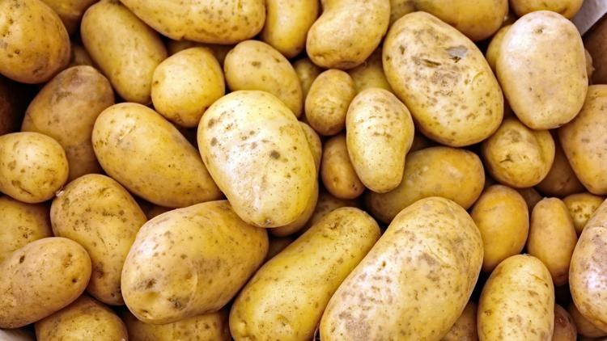
Imagining potato population in a truckload

Slide 10
Assumptions in each truckload
Each truckload will have all the varieties/types/sizes of potato.
Each truckload will produce multiple sizes of chips including small chips to large chips.
Considering the consensus of population of potatoes in a truckload we can predict probabilities or %ages of chips(small or large) that can be produced more in number.
We have got data from ~700 truckloads from 3 months.
Each truckload sums up into 1 data point in the data we have.

Slide 11
Methodology - ML Based approach
Step1: Data exploration - Get to know the data
Step2: Data exploration - Biases in data
Step3: Possible solutions - Based on data explorations
Step4: Feature engineering and data structurization
Step5: Train and Test models with binarization model
Step6: Train and Test models with multiclass model

Slide 12
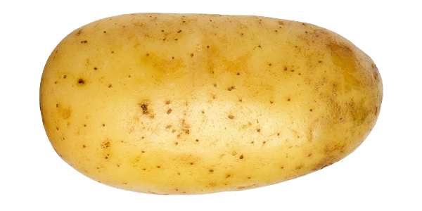
Methodology
Step2: Data exploration - Biases in data
Bias1: Angle of slicing

Slide 13
Types of population of potatoes vs angle bias
Type1 Population : [L and D] <2.5 in (Small Potatoes)
Produces only small chips (having L< 2.5 inches)
Type2 Population : [L and D] >2.5in (Bulky Potatoes)
Produces maximum large chips (having L>2.5 inches)
Type3 Population : [L >2.5 and D<2.5] in (TUBERS)
Most affected by angle bias
If it is sliced along the length, large chips (L >2.5 in) will be produced
If it is sliced along the diameter, small chips (L <2.5 in) will be produced

Slide 14
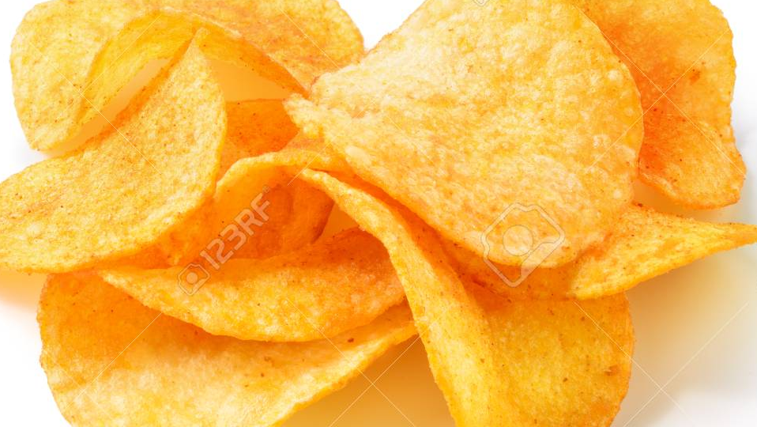
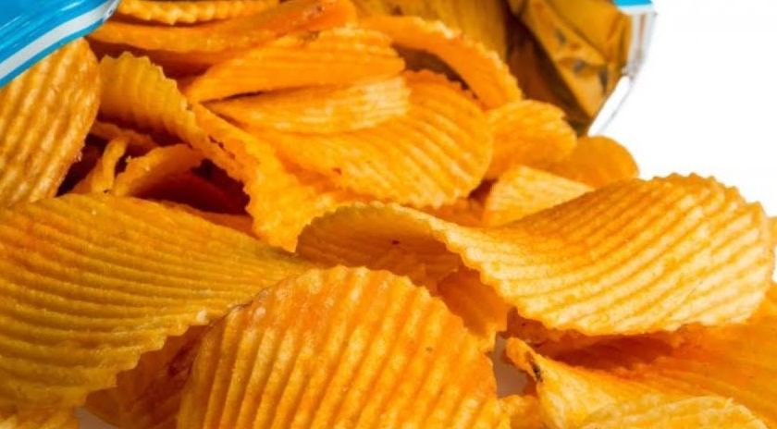
Bias2: Kind of chips produced from each workload would affect number of chips
No information on chips type is provided.

Slide 15
Bias3: Dimensions are from Image data (2D)
We have length, diameter & area for potatoes and length & area for chips
It does not consider factors like curves in chips, tapering ends of potatoes, maximum or minimum Diameter in potato, etc.
Hence, data is incomplete.
Bias 4: Lesser data points
Currently we just have 3 months data summing to ~700 data points.
Bias 5: Missing image data
Among 700 data points we have some missing data as well

Slide 16
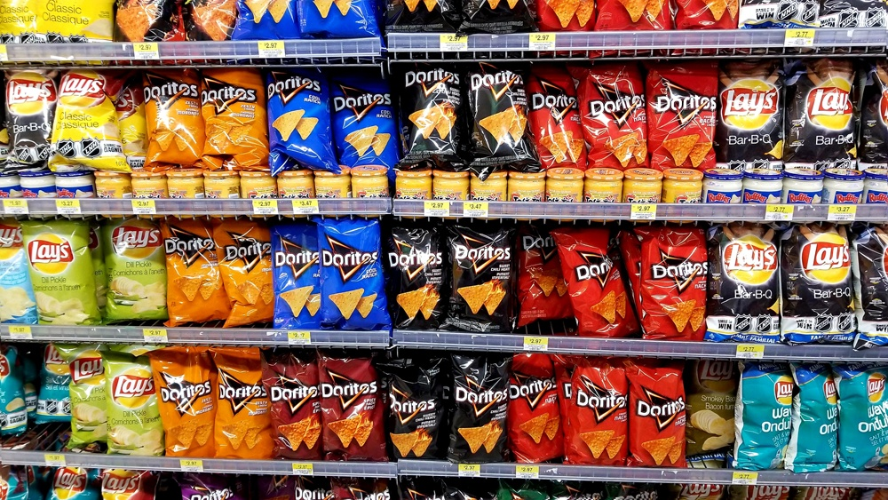
Bias 5: Population to population data
Current data considers that a sample population of potato with varying sizes would produce a sample population of chips with varying sizes.
However, given a potato with certain dimensions, how many corresponding chips would be produced? Not fully known..
1 truckload ultimately sums up into 1 datapoint

Slide 17
Methodology - ML Based approach
Step1: Data exploration - Get to know the data
Step2: Data exploration - Biases in data
Step3: Possible solutions - Based on data explorations
Step4: Feature engineering and data structurization
Step5: Train and Test models with binarization model
Step6: Train and Test models with multiclass model

Slide 18
Methodology
Step3: Possible solutions - Based on data explorations
Prediction of exact %age of large chips (having length >2.5 in) is practically challenging due to the biases.
Possible models/approaches can be classification based:
Approach 1 Binary Classification prediction model
Approach 2: Multi classification prediction model
Feature engineering and data structurization is must before modeling the data.

Slide 19
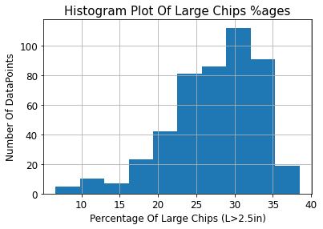
Few more take away from data:
After data cleaning, only 476/700 data points left.
Out of 476 data points, maximum %age of large chips (L>2.5in) obtained from any truck load was <40%
None of the truckload could produce >40% of large chips

Slide 20
Approach1: Binary Classification prediction model (Broader Classification)
Binarize the data points into categories of %age of large chips (L > 2.5in)
0-28% as category 1
>=28% as category 0
With this method data looked balanced in two categories with 28 as cutoff for binarizing categories. Out of total data Points (476)
Number of datapoints in >=28% slab(0)==> 247
Number of datapoints in <28% slab(1)==> 229

Slide 22
Approach2: Multi classification prediction model (Narrowed Classification)
Define categories for % of large chips (L>2.5 in), and then make predictions falling in either of these slabs.
0-10%chips defined as category 1
10- 20% as category 2,
20-30% as category 3,
30-40% as category 4
As per current data, there are 0 data points >40%.

Slide 23
Data is imbalanced when categorized in multi-classes.
Out of 476 data points available for training the model
6 data points in 0-10% slab of chips having L >2.5inch
46 data points in 10-20% slab
229 data points in 20-30% slab
195 data points in 30-40% slab
Currently, data is insufficient for this approach, still tried.

Slide 24
Methodology - ML Based approach
Step1: Data exploration - Get to know the data
Step2: Data exploration - Biases in data
Step3: Possible solutions - Based on data explorations
Step4: Feature engineering and data structurization
Step5: Train and Test models (with binarization approach)
Step6: Train and Test models (with multi-class approach)

Slide 25
Methodology
Step4: Feature engineering and data structurization
Engineering the right features to train the model with the statistics of data is very important.
Less features carrying more weightage is good to have.
Having features that correlate in certain way helps to make predictions in the right direction.
In current case, I engineered total 7 features.
In those 7 features, I also tried to get over angle bias of slicing using L/D ratio for TUBERS category.

Slide 26
Methodology
Step4: Feature engineering and data structurization
length (L)
Calculation of L/D ratio for
tubers (L>=2.5in and D=<2.5in)
(prone to max. Angle bias)
L/D ratio will help reduce the angle bias, as ML model can learn from the examples we provide.
Tubers having L/D ratio <1.25 will show very less angle bias. (If cut diametrically or longitudinally)(typically roundish potatoes)
Tubers having L/D >1.25 are expected to show major angle bias.
Dia (D)

Slide 27
Methodology
Set of 7 features created
Feature1: %age of small potatoes (L AND D) <2.5 in
Feature2: %age of bulky potatoes (L AND D) >2.5 in
Feature3: %age of TUBER potatoes (L >=2.5 AND D=<2.5in)
Feature4: %age of TUBER potatoes having L/D ratio == 1 (round)
Feature5: %age of TUBER potatoes having L/D ratio ~ [1-1.25] (roundish)
Feature6: %age of TUBER potatoes having L/D ratio ~ [1.25-2.5] (Fairly long)
Feature7: %age of TUBER potatoes having L/D ratio >2.5 (very long)
Target Column: %age of large chips produced [With categorized %age]

Slide 28
Methodology - ML Based Approach
Step1: Data exploration - Get to know the data
Step2: Data exploration – Biases in data
Step3: Possible solutions - Based on data explorations
Step4: Feature engineering and data structurization
Step5: Train and Test models (with binarization approach)
Step6: Train and Test models (with multi-class approach)

Slide 29
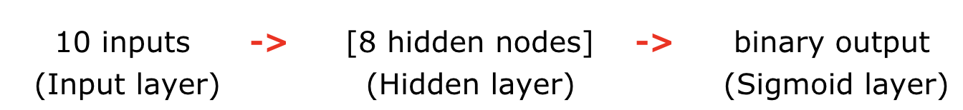
Methodology
Step5: Train and Test models (with binarization approach)
Trained the following models and tested them for accuracy:
Logistic Regression: With cross validation=10, C=1.
Neural Networks: Sequential with following architecture
Random Forest Classifier: With grid search and cross validation=10. (Depth=5, n_estimator=100)
XGBoost Classifier: With grid search and cross validation=10.
Notes:
The parameters were set after trying various parameters and finally settled to the mentioned parameters as per the accuracy. We just kept the final parameters that do not overfit but at the same time gives bestest of all accuracy as the current data available. Model grows continuously as the more and more data comes. These are definitely not the bestest parameters but best for now.

Slide 30
Methodology - ML Based Approach
Step1: Data exploration - Get to know the data
Step2: Data exploration - Biases in data
Step3: Possible solutions - Based on data explorations
Step4: Feature engineering and data structurization
Step5: Train and Test models (with binarization approach)
Step6: Train and Test models (with multi-class approach)

Slide 31
Methodology
Step6: Train and Test models (with multi-class approach)
Trained the following models and tested them for accuracy:
Logistic Regression: With grid search and cross validation=10
C=0.1
Random Forest Classifier: With grid search and cross validation=10
max_depth=10, n_estimators=50
XG Boost Classifier: With grid search and cross validation=10
booster='gblinear'
Notes:
Grid search helps in hyperparameter tuning and fetch the best value.

Slide 32
Result and Analysis
 | Binarization Approach |  | Multi-Class Approach
 | Training Accuracy | Testing Accuracy | Training Accuracy | Testing Accuracy
Logistic Regression | 63.42% | 67.70% | 52.65% | 56.30%
Random Forest Classifier | 60.50% | 62.50% | 50.44% | 48.74%
Sequential Neural Network | 64.21% | 66.67% | Not applicable due to less data in each category
XGBoost Classifier | 62.90% | 67.71% | 52.38 | 52.94%
Models

Slide 33
Result and Analysis
Tried two classification approaches out of which binarization approach performed better.
Multi-class approach suffered due to insufficient data.
Models trained with both the approaches exhibited average accuracy for predictions.
Models alone cannot make predictions betters. Data is also equally important.
Hence, I have some recommendations going forward in future.

Slide 34
Recommendations
Insufficient data: At least 6-9 months data required to train the model sufficiently, in current case.
Garbage-in garbage out: Data Quality has to be improved. Reduce missing data.
Right Data: Having some experimental lab data examples would be helpful
Like given some standard potato shapes and sizes, how many %age of large chips (L>2.5in) would be produced?
When enough data is available, neural networks approach would be effective with multi-classification approach.

Slide 35
Acknowledgements
James Yuan
Sr. Director – Data Science & Analytics
Hua Xu
Senior Principal Scientist - Data Science & Analytics
Sonchai Lange
R&D Engineer - Process & Product Development

Slide 36
Internship Learnings
Success metric
First and foremost understand the success metric for building any predictive model.
Understand the data
Data might not be complete always. Hence, it's a duty of a data scientist to explore, talk to cross functional team and decide if more data is required.
Discussions are must
Collaborative interactions within own team as well as with cross functional teams are must to be productive and successful in the endeavor
Be open in thoughts
Be open and confident about own perspective. Also, be open to receive any kind of suggestions/critiques.
Along with projects, networking is also equally important.

Slide 37


Questions?

Slide 38
APPENDIX

Slide 39
THANK YOU!!

